Slide 1
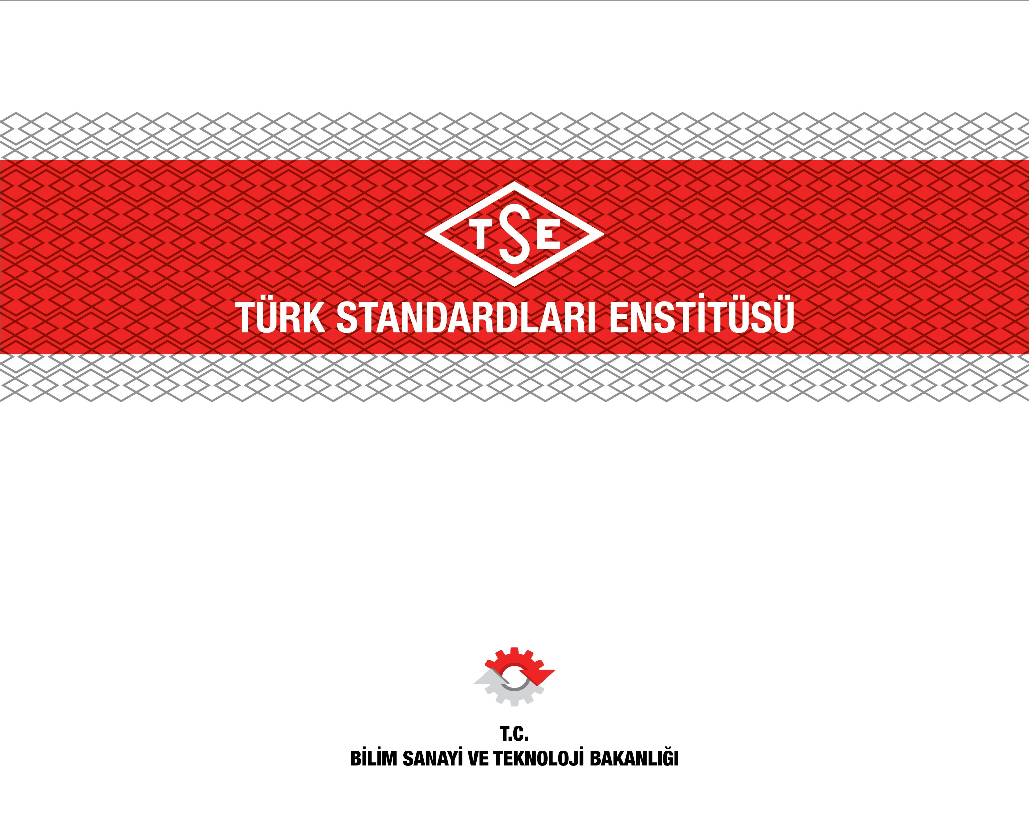
Importance of Education on Standardization
"Standardization 2019"
10-11 Oct. 2019, St.Petersburg, Russia

Slide 2

OUTLINE
ESTABLISHMENT
OUR CHALLENGES
INFRASTRUCTURE
TSE CAPABILITIES
OUR TARGETS
GLOBAL PROJECTS
INTERNATIONAL RECOGNITION
INTERNATIONAL MEMBERSHIPS
TSE In Brief - Part 1
Importance of Education on Standardization - Part 2

Slide 3
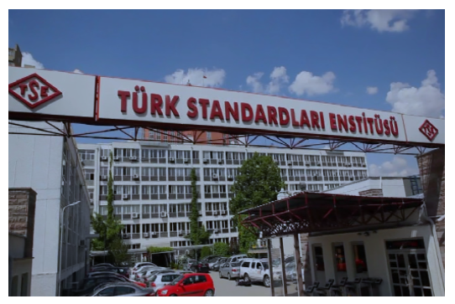
ESTABLISHMENT
National Standardization Body of Turkey (NSB)
Preparing and publishing the standards in all required fields since 1954.
Headquarters in Ankara; it has branch offices and numerous regional laboratories (Quality Campus, Gebze).
5 representative offices in worldwide:
  Azerbaijan, Kazakhstan, Uzbekistan, Turkish Republic of Northern Cyprus and Kingdom of Saudi Arabia.

Slide 4




INFRASTRUCTURE (1)
  TSE has 4 joint ventures, they are:
    Uzbek-Turk Test Centre
    TSE-Sojuztest Metrology and Calibration Co. Ltd.
    International Conformity Assessment Service (ICAS)
    Muallimköy Technology Development Region - Informatics Valley
  Currently; around 3075 full-time staff in total.

Slide 5
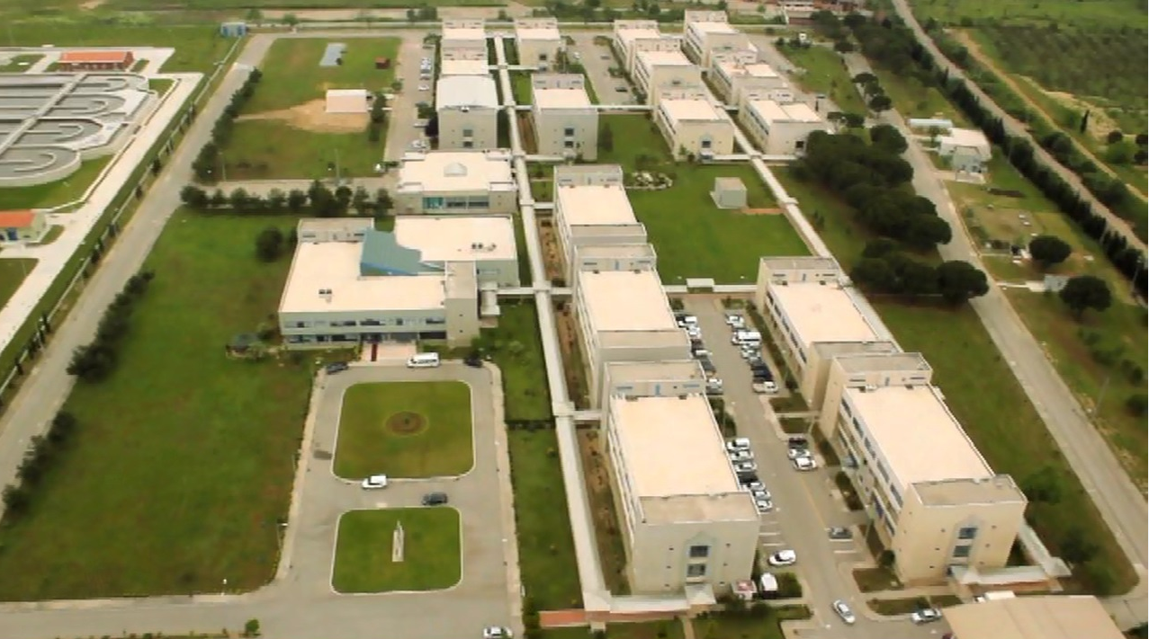
INFRASTRUCTURE (2)
TSE Quality Campus
Set up through the financial aid obtained by the World Bank under “The Technological Development Project” in 1998.
Built on;
276.500 m² of land,
40.000 m² of enclosed space,
20 separate buildings majority of them are laboratories.

Slide 6
TSE CAPABILITIES (1)
TSE
Standardization
Certification
Surveillance and Inspection
Training
Transportation and Logistics Systems
Testing and Calibration

Slide 7
TSE CAPABILITIES (2)
Standard Preparation
Original Turkish Standards | 7.796
ISO and IEC Standards adopted as Turkish Standards | 4.940
EN Standards adopted as Turkish Standards (CEN/CENELEC) | 24.042
OIC/SMIIC Standards adopted as Turkish Standards | 4
Valid Turkish Standards (in total) | 36.782
Ratio of EN Standards adopted as Turkish Standards | % 98
* Figures may vary.

Slide 8

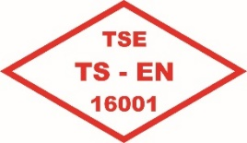

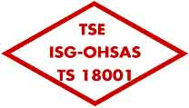

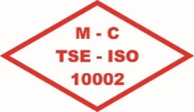
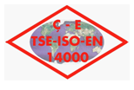
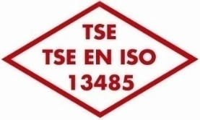

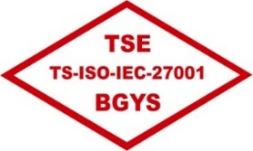
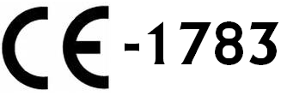


TSE CAPABILITIES (3)
Certification
CERTIFICATION TYPE | # of CERTIFICATES ISSUED
Management Systems | 3.767
Product and Service Certification | 49.855
Personnel Certification (# of Experts on Halal Food Technical Inspection:264 ) | 8.507
* Figures may vary.

Slide 9
TSE CAPABILITIES (4)
EU Directives - Notified Body
Reg. (EU) 305/2011 | Construction products
Reg. (EU) 2016/425 | Personal protective equipment
92/42/EEC | Hot-water boilers
2014/33/EU | Lifts and safety components for lifts
2014/68/EU | Pressure equipment
Reg. (EU) 2016/426 | Appliances burning gaseous fuels
93/42/EEC | Medical Devices
2014/31/EU | Non-automatic weighing instruments
98/79/EC | In Vitro Diagnostic Medical Devices
2014/34/EU | Equipment and protective systems intended for use in potentially explosive atmospheres
2014/32/EU | Measuring Instruments Directive

Slide 10

OUR TARGETS
  Enhancing cooperation in the fields of
    Standardization,
    Conformity Assessment (Testing, Inspection, Certification),
    Metrology and Calibration
  Collaborating in the field of Pre-Shipment Inspection (PSI) for the products entering not only from Turkey to targeted countries, but also from other countries to targeted countries’ markets.
  Halal Certification according to OIC/SMIIC Standard.
  Providing technical assistance and consulting services with a view to strengthening the quality infrastructure of least-developed countries.
  Establishing a platform among neighbour countries in order to take part actively in decision making organs of World and Regional Standardization Organizations such as ISO, IEC, CEN and CENELEC.

Slide 11

OUR CHALLENGES
Create Added Value for Customers
Leadership in Regional Standardization
Effective Role in Decision Making Process of World Standardization Organizations
Promote Strategic Collaboration
Become Global Actor

Slide 12



GLOBAL PROJECTS
BODY & COUNTRY | EXPLANATION | TIME INTERVAL
SASO, Kingdom of Saudi Arabia | Co-certification in management systems certification | On-going
Institute for Standards of Bosnia & Herzegovina (BAS) | Co-certification in management systems certification | On-going
Institute for Standards of Bosnia & Herzegovina (BAS) | Trainings on management systems certification | 2014
ARDNŞ (SOCAR) Telim, Tedris Ve Sertifikatlaşdırma İdaresi Azerbaijan | Consultancy in personnel certification on welding and EN ISO/IEC 17024 | 2011

Slide 13

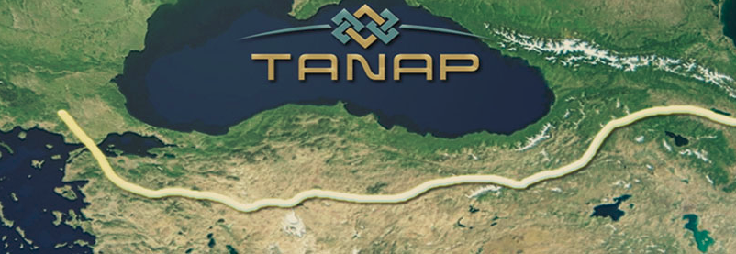
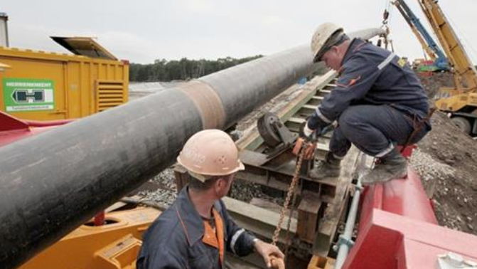
SOME SPECIAL PROJECTS (1)
TANAP (Trans Anatolian Natural Gas Pipeline Project)
Partner of the consortium
3rd party inspection activities are carried out in three factories, located in China, regarding the manufacturing process of pipelines.

Slide 14
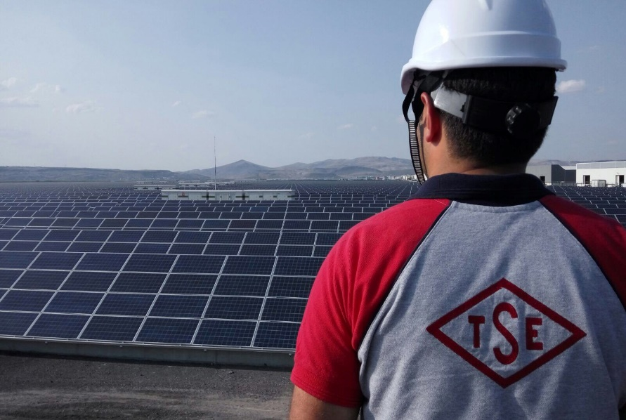
SOME SPECIAL PROJECTS (2)
Photovoltaic (PV) Energy Systems
Solar Energy Power Plant Gebze: 1 MW, established in 2016
PV Module tests and certification
Inspection and surveillance services
Standardization (CENELEC TC 82 ‘Solar photovoltaic energy systems’ membership)

Slide 15
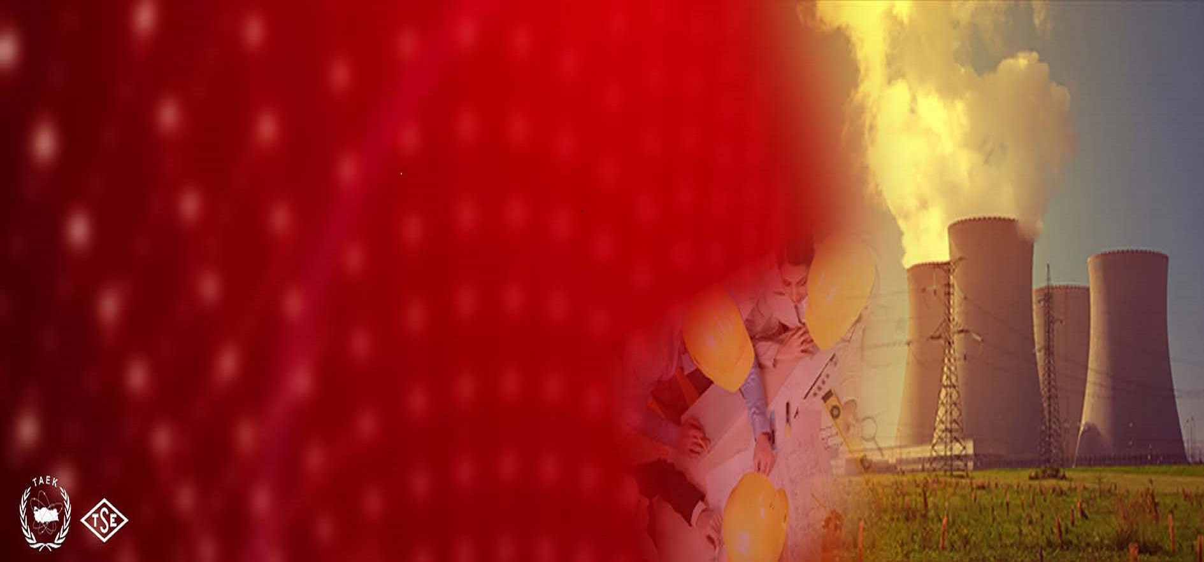
SOME SPECIAL PROJECTS (3)
Nuclear Energy Systems
Nuclear Manufacturer Approval
(around 30 manufacturers)
Nuclear Power Plants (NPP) Manufacturing Process Inspections Technical Support Services
Technical Support for Civil and Site Audits of NPPs
(contract signed between TAEK and TSE)

Slide 16



INTERNATIONAL RECOGNITION
Product, personnel and system certification, testing and calibration activities accredited by the Turkish Accreditation Agency (TÜRKAK) which is the full member of European Accreditation (EA).
Personnel certification activities are also recognized by the European Organization for Quality (EOQ).
The Certificates granted by TSE are recognized internationally.

Slide 17







INTERNATIONAL MEMBERSHIPS (1)
ORGANIZATIONS
International Organization for Standardization (ISO)
International Electrotechnical Commission (IEC)
World Packaging Organization (WPO)
European Organization for Quality (EOQ)
Standards and Metrology Institute for Islamic Countries (SMIIC)
European Committee for Standardization (CEN)
European Committee for Electrotechnical Standardization (CENELEC)

Slide 18






INTERNATIONAL MEMBERSHIPS (2)
ORGANIZATIONS
Interregional Standardization Association (IRSA-BASB)
The International Certification Network (IQNet)
Worldwide System for Conformity Testing and Certification of Electrotechnical Equipment and Components (IECEE)
European Certification Schemes for Electrical Products (EEPCA)
Common Criteria Recognition Agreement (CCRA)
Bureau International des Containers (BIC)
ECO Regional Institute for Standardization, Conformity Assessment, Accreditation and Metrology (RISCAM)
RISCAM

Slide 19
OUTLINE
ESTABLISHMENT
OUR CHALLENGES
INFRASTRUCTURE
TSE CAPABILITIES
OUR TARGETS
GLOBAL PROJECTS
INTERNATIONAL RECOGNITION
INTERNATIONAL MEMBERSHIPS
TSE In Brief - Part 1
Importance of Education on Standardization - Part 2

Slide 20

Role of Countries (1)
Clean water, food and environment
Healthcare
Education and careers
Communication and transportation

Slide 21
Role of Countries (2)
Well established infrastructure is needed
For goods and services to be accessible (education)
Named as «quality infrastructure»:
  Standardization
  Metrology
  Conformity Assessment
  Accreditation

Slide 22
Role of Countries (3)
What is Standardization?
Why important?
Some serious initiatives have been launched to raise standardization consciousness.
Establishment of it in all interested parties and formation of awareness in national, regional and international standardization studies can only be achieved thru education.

Slide 23
Role of Countries (4)
Standardization is voluntary by its nature and so is the participation.
It is of great importance for every actor within the chain of standards makers and users to create awareness and make contribution to the standardization development.

Slide 24
Role of Countries (5) – Who are the Stakeholders?
Consensus on standardization can only be achieved by the contribution of all stakeholders
Industry
SMEs
GOs
Chamber of Commerce
Consumer
STANDARDIZATION
Private sector
R & D Org.s,
Universities
NGOs

Slide 25
Role of Countries (6)
Why to develop standardization consciousness?
No industrial product occurs spontaneously, emerging as one’s dream, design, work and effort and is ultimately driven to market.
A product has not a value if there is no consumer.
We can realize what, why, for whom, how and how much we produce if only we implement standards more economically and efficiently.

Slide 26
Role of Countries (7)
To be a standard maker, it is required to know standardization and standardization culture.
Standardization is an inevitable need. The only way to meet this need passes from engaging in standard preparing processes.
To strengthen our economy, improve our industry and not to remain weak in the global competition, standards that everyone can accept and conform can only be achieved thru conscious and competent standard makers.

Slide 27
Role of Countries (8)
How can the standardization consciousness be developed thru education? (key question)
To create awareness regarding standards and standardization, various methods are used to improve the participation of the interested Parties concerned.
Two key issues often considered in the field of education:
  Standardization training, standardization expertise (Standard Engineering for some),
  Practical training to ensure the use and effectiveness of existing standards. (nothing but hands-on training)

Slide 28
Role of Countries (9)
Today, countries in the world keep standardization education as an important ingredient in their national standardization strategy papers and national standardization policy.
This offers significant support to the standardization consciousness.
Lifelong standardization education should be located at the top of country’s standardization strategies.

Slide 29
Role of Countries (10)
International, regional and national standards organizations and working platforms are gradually being created. Some are:
  International Cooperation for Education about Standardization (ICES),
  European Academy for Standardization (EURAS),
  Joint Working Group on Education about standardization (JWG-EaS) together with CEN, CENELEC and ETSI,
  Some training programs in collaboration with universities in most Asian countries.

Slide 30
Role of Countries (11)
In the abstract of ‘White Paper Academic Standardization Education in Europe’ of EURAS it is stated as: “Standardization is a strategic asset at the level of companies, industry sectors, countries and regions. To excel in standardization, proper education is needed.”

Slide 31
Role of Countries (12)
Standardization education is an indispensable element for the implementation of standards in institutions.
Without education it is almost impossible for institutions to implement standards in their products, processes and applications.
Education as the source of the ability, brings width of perspective, implementation capability, competitive advantage to individuals and organizations.
Therefore, if any country wants to maintain standardization and economic power, it must give priority to standardization education.

Slide 32
Role of Countries (13) – Training Modules
Education level | Target | Responsible Stakeholder | Content | Method
Primary edu. (upto 10/11 years) | -awareness | -GOs -NSBs | -sample stds in everyday life -general info | -quizes, games -drawings, leaflets -brochures
Secondary edu. (upto 17/18 years) | -awareness -understanding -tech knowledge on specifically well defined domains | -GOs -NSBs | -sample stds in everyday life -general info -teaching the use of some stds | -quizes, games -leaflets, contests, videos -handbooks -internet
Vocational Training | -awareness -understanding -tech knowledge on specifically well defined domains -theory | -GOs -NSBs -various related org.s | -sample stds in everyday life -general info -case stdies -teaching the use of some stds | -contests, videos -handbooks -internet -team project -presentations -workshops
Higher education | -understanding -specialized knowledge -theory -interaction between innovation and stdzation | -universities -GOs -NSBs -various related org.s | -general info -academic stdies -case stdies -teaching the use of some stds -skill sets | -contests, videos -handbooks -internet -team project -presentations -workshops -case stdies

Slide 33

Education in Turkey (1)
Ministry of National Education
  a government ministry
  responsible for the supervision of public and private educational system under a national curriculum except higher education

Slide 34

Education in Turkey (2)
Council of Higher Education (YÖK)
  an autonomous institution
  responsible for the planning, coordination and governance of higher education system in Turkey in accordance with the Turkish Constitution and the Higher Education Laws
  # of universities: 207

Slide 35
Education in Turkey (3)
Quality Assurance in YÖK
  Regulation is prepared to establish quality standards.
  Internal evaluation process held annually in accordance with this Regulation.
Qualifications, Quality Assurance and Accreditation Commission (YÖKAK) has been constructed
  development of quality, and approval and recognition of quality levels thru independent "external evaluation" process

Slide 36
TSE’s role to Standardization Education (1)
TSE organizes training programs for many years in order to demonstrate the importance of standardization and to ensure implementation of standards in particular.
Elective courses for Technical High School Students (standardization and quality),
Monthly periodical magazine «STANDARD»,
Children's magazine «ÖNCÜ» (quarterly), meaning «Pioneer»,
Play (Theatre) for children «ÖNCE KALİTE», meaning «quality first».
Article and Picture Contests,
Certification on TS ISO 29990 ‘Learning services’.

Slide 37

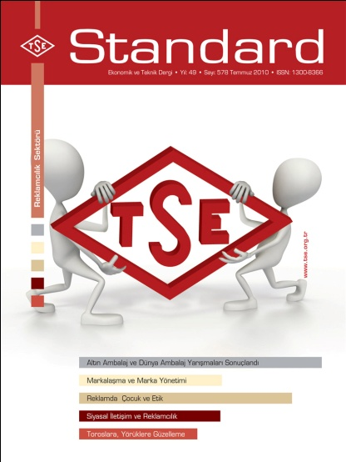
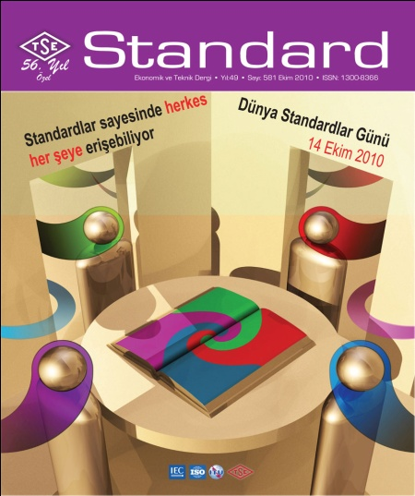
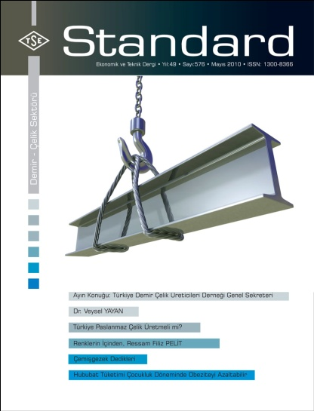

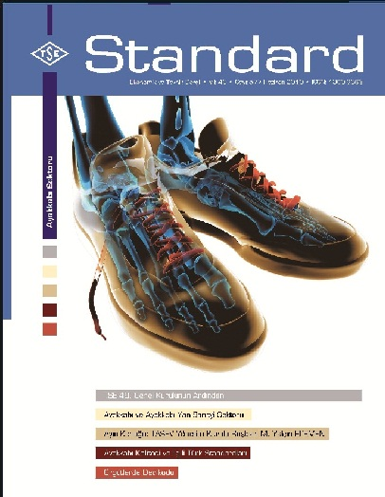

TSE’s role to Standardization Education (2)
Periodical magazine «STANDARD»

Slide 38


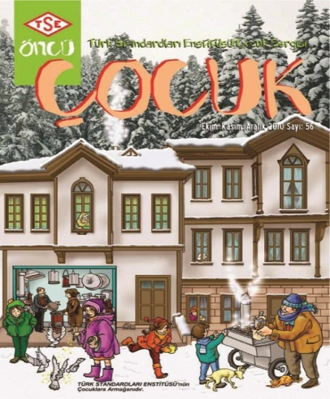
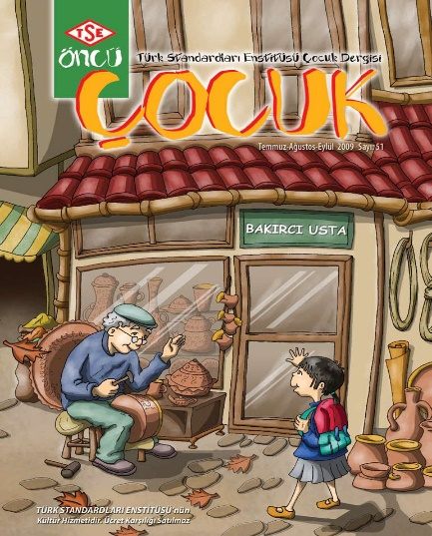


TSE’s role to Standardization Education (3)
Children's magazine «ÖNCÜ»

Slide 39
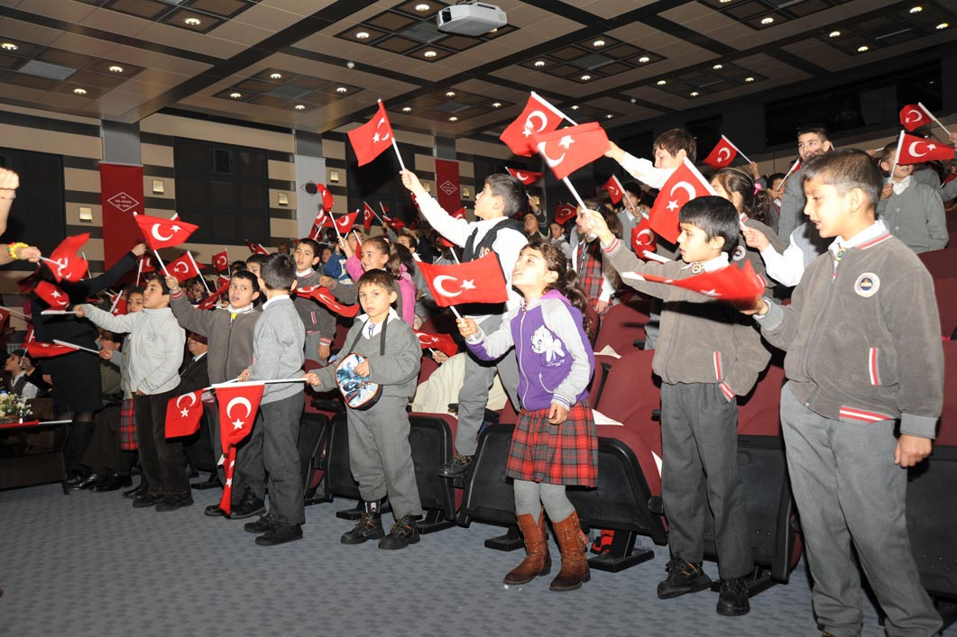
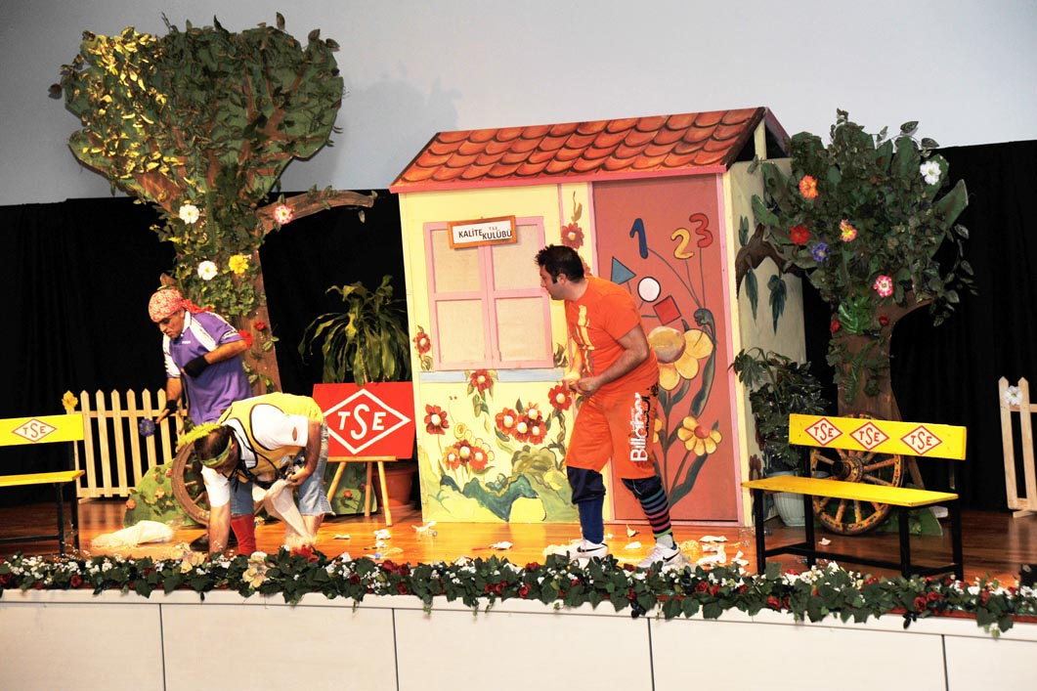
TSE’s role to Standardization Education (4)
Theatre for children «ÖNCE KALİTE»

Slide 40
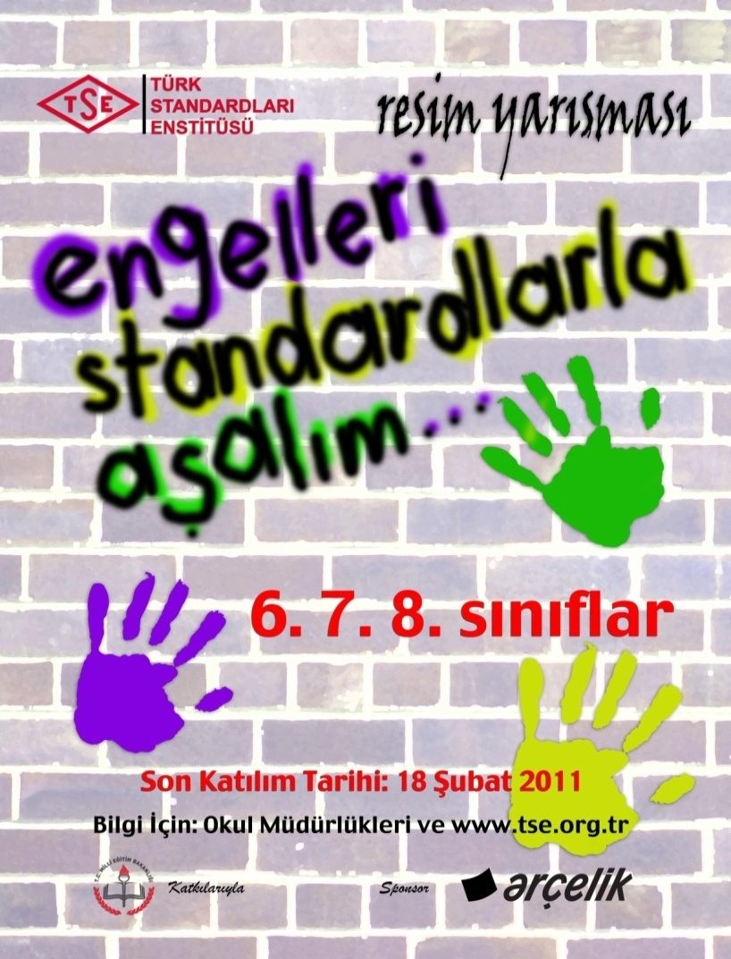

TSE’s role to Standardization Education (5)
Article and Picture Contests

Slide 41
TSE’s role to Standardization Education (6)
About KUDEM (Quality and Conformity Assessment Engineering)
Programme started in Sept. 2014 with 37 students in Hacettepe University.
Purpose: Unlike Standardization Engineering, covers issue of implementation of standards, innovation and audit expertise.
  Target applicants:
    B.Sc. Graduates in technical and administrative disciplines,
    Experienced professionals.
  Graduates:
    Obtain M.Sc. diploma and TSE Certificate,
    Get an opportunity to be an internationally recognized technical expert.
  Web site: www.kudem.hacettepe.edu.tr

Slide 42
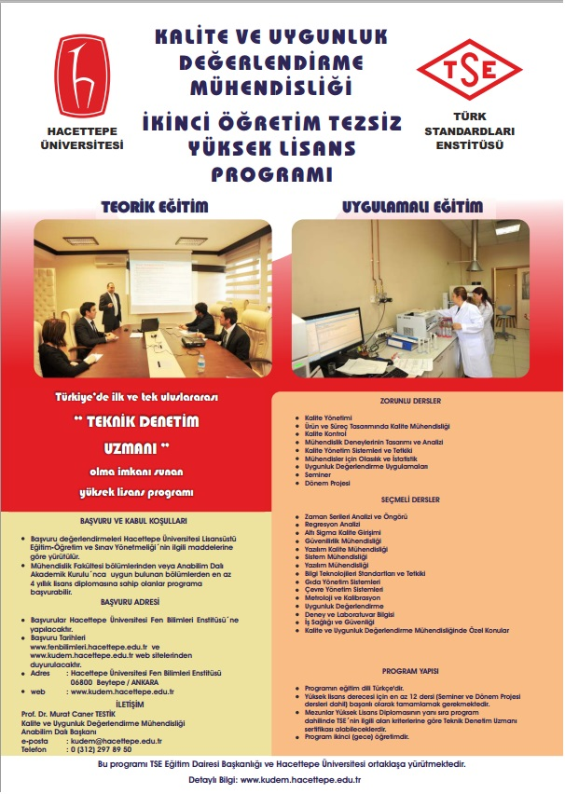
TSE’s role to Standardization Education (7)
KALİTE VE UYGUNLUK DEĞERLENDİRME MÜHENDİSLİĞİ TEZSİZ YÜKSEK LİSANS PROGRAMI
(KUDEM)

Slide 43
TSE’s role to Standardization Education (8)
KUDEM Curriculum (M.Sc.);
  1.5 years (3 terms),
  5 mandatory courses (plus 2 electives),
  1 seminar, 1 project, no thesis,
  With a total of 41 credits.
  Currently;
  Around 80 students,
  5 full-time, 2 part-time instructors.
* Figures may vary.

Slide 44
TSE’s role to Standardization Education (9)
Mandatory Courses
Code | Course Name | T-P-K
KUM611 | Probability and stochastic processes for engineers | 3-0-3
KUM620 | Quality control | 3-0-3
KUM622 | Design and analysis for engineering tests | 3-0-3
KUM692 | Seminar | 0-2-0
KUM699 | Term project | 0-2-0

Slide 45
TSE’s role to Standardization Education (10)
Some Elective Courses
Code | Course Name | T-P-K
KUM661 | Metrology and Calibration | 3-0-3
KUM653 | Six Sigma Quality Management | 3-0-3
KUM660 | Environmental Management System | 3-0-3
KUM659 | Food Safety Management System | 3-0-3
KUM655 | Software Quality Management | 3-0-3
KUM658 | Information Technology Standards and Audit | 3-0-3
KUM663 | Conformity Assessment Applications | 1-4-3
KUM665 | Occupational Health and Safety | 3-0-3

Slide 46
Summary - Results (1)
To create awareness in the need and importance of education; (in this regard, engaging in activities, projects research, conferences, seminars, web presentations, etc.),
To promote training courses in this field and cooperate with educational institutions; (for example, social media tools to use, publishment of internet-free video presentations, TV programs and animations, improve educational laboratory, etc.),
To include standardization education as an elective course to the curriculum in basic education, university education and lifelong learning,

Slide 47
Summary - Results (2)
To create a resource and educator pool for standard education and give support to educational institutions,
To provide standardization education consulting services for educational institutions; (for example preparing a model curriculum for universities),
To facilitate the accessibility of standard education via distance education technologies,
Industry-based social activities can be organized to increase awareness on standards,
To organize competitions of scientific articles to be written for the standards,

Slide 48
Summary - Results (3)
To participate in the activities of the National Education plan for standards to be taken place in educational institutions.
Briefly, standardization education;
  creates a secure environment for investments,
  supports for innovation,
  creates new markets,
  improves the quality of labor,
  provides employees a new skill area,
  increases the competitiveness of firms.

Slide 49

“ He who runs the information runs the show. ” (Bernard Shaw)
спасибо
thanks
teşekkür

