Slide 1
Challenges for Standardization
John Pace
Senior Vice President, ASTM Int’l Forum – Standardization 2019
www.astm.org

Slide 2
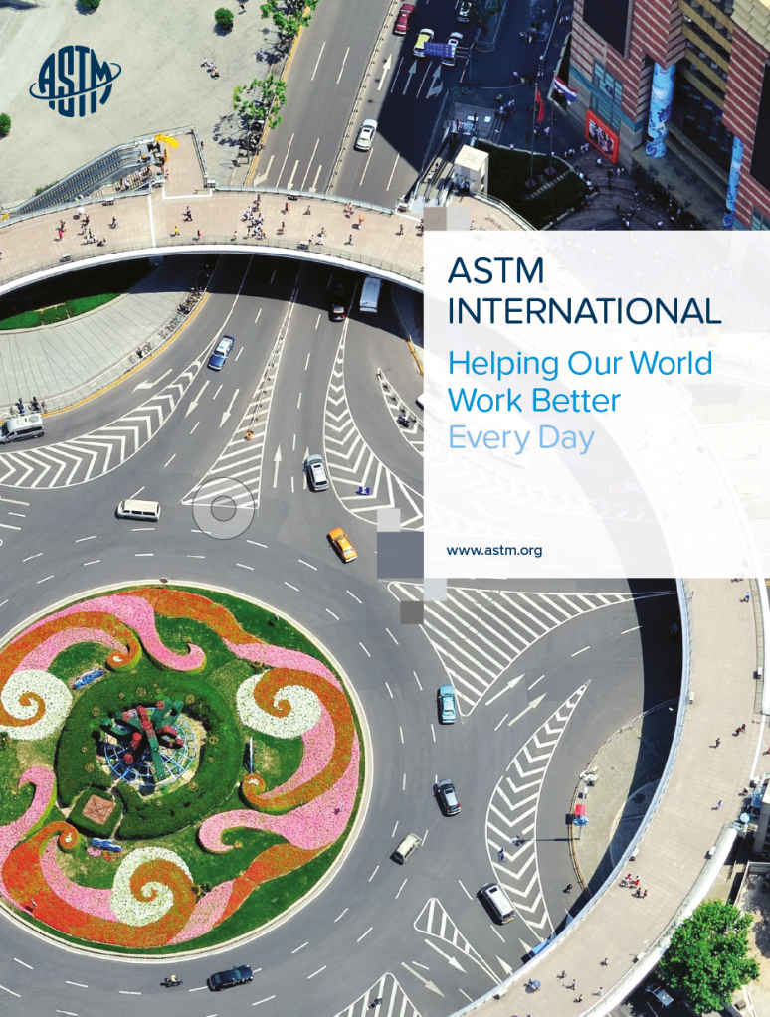
Overview of ASTM
﻿Organized in 1898 - American Society for Testing & Materials
﻿One of the worlds largest standards developing organizations
﻿﻿Publish standards, specifications, test methods, books, journals, conference papers & manuals
﻿Funded mainly through income from sales
﻿Internationally recognized
Partnerships with ISO, IEC, and CEN
Partner with Rosstandart
Partner with over 150 NSBs and SDO
﻿Not for profit
﻿HQ – Philadelphia, USA

Slide 3
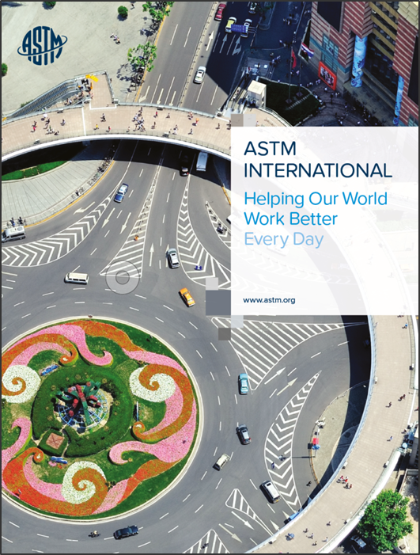
Overview of Today’s Challenges
Challenges from the “Macro” View
Apply to:
Individual User/Customer
Corporate Level
Standards Development Organizations

Slide 4
Challenges to Standardization Today
1. Defending the Value vs Cost/Price Debate
Standards considered “expensive” by many
Standards costly to develop
Value
Development – eliminates redundancy
Safety
Reliability
Overall Productivity Savings and Gains in Accessing/Using
From an engineering perspective, in evaluating simply the identification, use, and convenience aspect of digital standardization, productivity savings have gone up more than 50x from the “old days” of using paper standards

Slide 5
Challenges to Standardization Today
2. Publishing Costs and Technology
Technology is expensive
Technology is constantly changing
Paper/books represent one time cost
Technology involves development, hardware, software, hosting, serving
.....and yet most standards developers have kept price increases relatively low and made standards a good value to users/companies

Slide 6
Challenges to Standardization Today
3. Technology Advancements
Technology and Innovation Continue to Change Our Business Much More
Technical Reports
New Derivative Offerings
New Areas of Standardization
Additive Manufacturing
Robotics
Exoskeletons
Growth/expansion of “smart grid” concepts
New Tools for Search/Discoverability, Linking, and Use
(Semantic Searching and Artificial Intelligence)

Slide 7
Challenges to Standardization Today
4. Threat of “FREE”
To some customers/users, this may sound appealing
Free is not always Free
Numerous threats today from government mandates to attacks from “others with a cause”
Free represents a threat to existing business models
Existing ASTM model enhances openness, participation…costs are tied to downstream usage
Free would mandate a change to existing model and processes

Slide 8
Challenges to Standardization Today
5. Copyright Concerns
All ASTM intellectual property is protected by copyright
ASTM IP cannot be reproduced, republished, or distributed without an authorized license agreement
We can set the rules for our IP
Copyright vs Licensing
Fair Use
Distribution and Licensing Use above and beyond Fair Use
Translations remain a challenging issue in Russia and are a major part of our copyright concerns (to be covered in next slide)

Slide 9
Challenges to Standardization Today
6. Translations
Copyright vs Licensing
Technical Accuracy
Limitations of Liability
Reference or Use/Implementation issues of licensing
ASTM has a monopoly over its own copyright !!...we can set the rules for our IP
Illegal translating companies
Not officially recognized
Could be dangerous if technical errors or irregularities

Slide 10
Challenges to Standardization Today
7. Issues of Duplication, Harmonization, and Adoption
Unnecessary duplication unnecessary and confusing
Old days of “branding mentality” are changing
ASTM approach includes partnerships, adoptions w/ attribution, and normative referencing
Existing partnership with Rosstandart addresses these
New partnerships with ISO, IEC, and CEN
Revisions do represent a challenge
Companies which want to push/reference ASTM translations into Russian GOST system….what is the new process?

Slide 11
Challenges to Standardization Today
8. Importance of Partnerships and Communication
ASTM is much stronger today because of MOU partnerships
Communication enhances understanding, enhances collaboration and often leads to new innovation
Rosstandart and Russian Customers are important to ASTM and our future

Slide 12
Challenges to Standardization Today
9. Remaining Relevant
Standardization Developers must remain RELEVANT in changing
times
Addressing New Needs and New Areas of Standards
Increasing Value to Customers
Importance to Move At Speed of Today’s Technology

Slide 13
Challenges to Standardization Today
10. Other Miscellaneous Issues
Privacy Issues
Closed Standards

Slide 14
Questions ??

Slide 15
Спасибо!
John Pace
jpace@astm.org
+1(610)832-9632

