Slide 1
global market access
Gabriela Ehrlich
IEC Global Head Public Affairs & Advocacy
Standardization Forum 2019
10 October 2019
St. Petersburg, RF

Slide 2
Global reach: 173 countries
IEC CO Geneva
IEC-ReCNA
Boston
IEC-APRC Singapore
IEC-LARC
São Paulo
IEC-AFRC Nairobi
86 Members 87 Affiliates
IECEx/IECQ Sydney
Notes:
The IEC is a global, not-for-profit membership organization that brings together 173 countries.

Slide 3
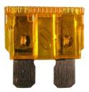
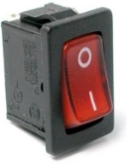
Scope of the IEC
Underpins global trade in electrical and electronic devices
Safety, security of data, people and the environment
innovation
Infrastructure development
Smart urbanization, transportation
Energy access and efficiency
Notes:
IEC work in standardization and conformity assessment underpins international trade in electrical and electronic goods, technical innovation, affordable infrastructure development, smart urbanization and transportation systems, efficient and sustainable energy access, and the safety and security of data, people and the environment.

Slide 4
Largest multinational agreement
Thousands of testing laboratories
< one million certificates
Accepted globally
No duplication
Less time and cost
One test…one certification – many markets
Notes:
The four IEC Conformity Assessment Systems and its members form the largest and best known multilateral agreement based on one-time testing of products globally.
Several thousand testing laboratories participate in them and they have issued more than 1 million certificates to date.
Each member of a System automatically accepts the conformity certificates and reports of all other System members. There is practically no duplication, no waste of time or money. Manufacturers are able to access markets faster and at less cost. This activity has been endorsed by the WTO Technical Barriers to Trade Agreement for many years.

Slide 5
IEC and SDGs
IEC work = technology focussed
Global consensus
Often used in regulations
Underpins 16 of 17 SDGs Each SDG = system with many sub systems
Notes:
IEC work directly impacts the targets of 16 of the 17 sustainable development goals.
It provides the technical foundation that allows countries and industries to import or build sustainable infrastructure and devices and is often used in regulations.

Slide 6
Technologies = many SDGs
Only few IEC Standards can be attributed to a single SDG
Motors = everywhere = most SDGs
Energy efficiency = many different standards in a systems approach
Made by experts for experts
Notes:
The IEC is technology focussed and most technologies are relevant to more than one SDG.
For example:
Electrical motors are everywhere: in pumps, refrigerators, air conditioners, medical devices, transportation, etc. etc. and they are relevant to most SDGs.
Energy efficiency is underpinned by hundreds of standards, often in a systems approach.
Sometimes replacing an old technology, for example incandescent lamps with LED can save a lot of energy.
Important: IEC Standards are always used by technical experts.

Slide 7
Behind the scene but essential
Reliability, efficiency, interoperability, quality & risk management
Underpin testing and certification
Notes:
IEC International Standards are essential for safety and reliability of most electrical and electronic devices. They also form the basis for testing and certification. The IEC Conformity Assessment Systems verify that systems used in homes, offices, healthcare facilities, manufacturing, lighting, energy services, explosive environments, electronics supply chains or renewable energy generation perform as they should.

Slide 8
speed of innovation
Notes:
In electrotechnology, the speed of innovation has accelerated to the point where individual companies can no longer develop everything alone.

Slide 9
Collaboration is indispensable
Notes:
While companies are fiercely competitive, they now must collaborate more than ever before to deliver the broad solutions for increasingly complex systems. In this IEC International Standards are already a key enabler.

Slide 10
Pre-conditions for digitalization
Electricity access
Information, communication and sensor systems
Computing power and data analytics
Notes:
Standards also are essential enablers for digitalization in energy, healthcare, transportation or manufacturing.
Wide-ranging digitalization directly depends on electricity access and broad installation of interoperable information, communication and sensor systems.
It also requires extensive computing power and data analytics.

Slide 11
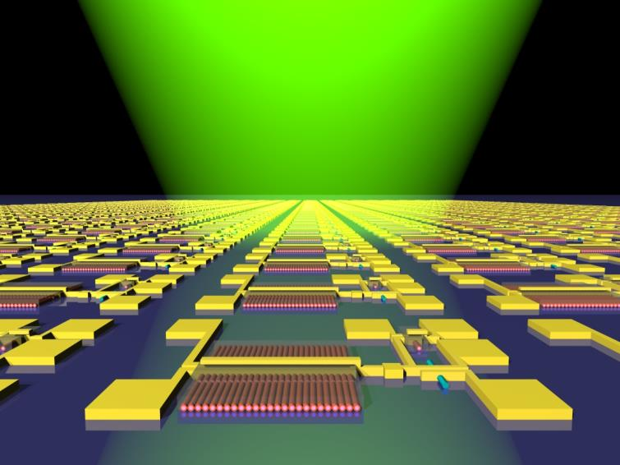
Unprecedented integration
Sensor networks
Control and algorithms
Big data
Cloud and edge computing
Greater efficiencies, new opportunities
Notes:
Digitalization will require the integration of many devices and systems.
It includes a wide range of sensors, artificial intelligence, control and algorithms, big data, cloud and edge computing, etc.
Together they will enable greater operational efficiency, opening up new business opportunities and transforming the way organizations interact with customers, suppliers, employees and governments.

Slide 12
Standards are a must
Essential for connectivity and interoperability without special integration efforts
Provide foundation for smart manufacturing
Notes:
Technical Standards are of central importance in allowing systems to interact with other systems without special integration efforts.
They help strengthen the foundation of intelligent manufacturing and the IoT. They will enable interoperability of data and intelligent systems from different vendors.

Slide 13
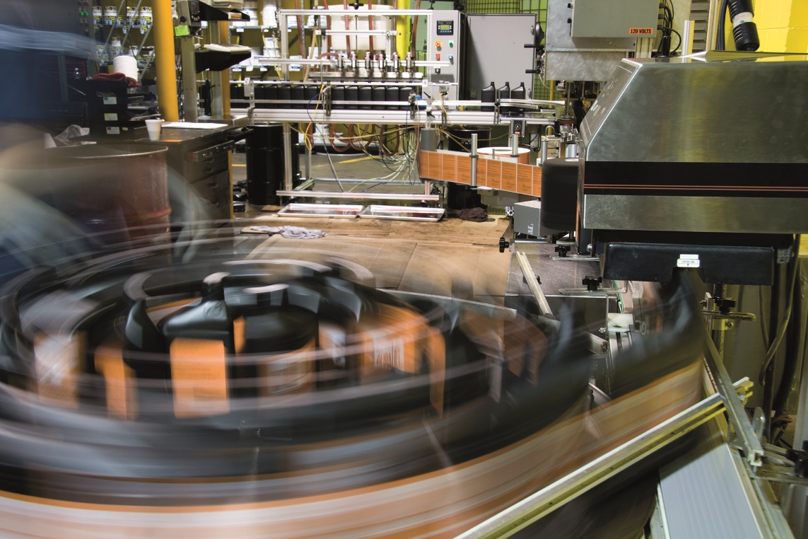
Broad cooperation needed
Processes and plant floor largely covered by IEC work
Systems approach: SyC smart manufacturing
Close cooperation with ISO, ITU, IEEE, fora, consortia
Notes:
IEC Standards help improve plant safety, security and availability and enhance product reliability and quality.
They address for example equipment and personnel, sustainability and environmental considerations, energy supply and energy efficiency.
Smart manufacturing requires close collaboration between various standards organization. No single standards organization is able to deliver everything that is needed alone.

Slide 14
Systems approach to accelerate integration processes
Notes:
For increasingly complex systems and converging technologies we need to take a different approach to standardization.
Systems standards require that we understand the top-level structure of the system as well as its many individual elements. They are the result of coordinated and early participation of many experts from different technical areas.

Slide 15
Standardization Evaluation Group
Who is impacted?
Who needs to cooperate – participation of all interested parties!
Systems architecture
Road-maps
Systems boundaries
Gaps/missing processes
Notes:
IEC Standardization Evaluation Groups identify all stakeholders who are impacted by a system. They define systems architectures, build road-maps and trace systems boundaries. They also detect standardization gaps or missing processes.
Standardization Evaluation Groups are completely open. They welcome all interested parties, including some that were never involved in the IEC.

Slide 16
Current SEGs
SEG 8 Communication technologies
SEG 9 Smart homes & buildings
SEG 10: Ethics in autonomous and artificial intelligence applications
SEG 11 Future sustainable transportation
Notes:
SEG 8 Communication technologies, focuses on system aspects such as interfaces, data models, security, privacy, etc.;
SEG 9 Smart homes & buildings, is mandated with developing a high-level landscape for standardization related to electrical installations and communication technologies;
SEG 10, Ethics in Autonomous and Artificial Intelligence Applications, will identify ethical issues and societal concerns related to IEC technical activities, and develop guidelines on ethical aspects related to autonomous and AI applications.
SEG 11 Future sustainable transportation, is to assess best practices for public shared transportation in developed and developing countries.

Slide 17
Systems Committees
Active role in coordinating standards development, interfaces, use cases
Reach out/work with other groups
Address the complexity & interoperability of the systems domain
Notes:
IEC Systems Committees coordinate the work of different IEC technical committees and outside experts to address system complexity and interoperability.

Slide 18
Current SyCs
SyC Smart Energy
SyC Active Assisted Living
SyC Smart Manufacturing
SyC LVDC
SyC Smart Cities
Notes:
Current SyCs address smart energy, active assisted living, smart manufacturing, low voltage direct current and smart cities.

Slide 19
A highly strategic tool
Active participation = significant market advantages, signal national needs/differences
International standards = easier to adopt nationally
Notes:
Standardization is an important strategic tool.
Active participation in international standardization helps ensure that national needs and differences are taken into account. As a result international standards are easier to use and adopt nationally. Testing and certification becomes faster, simpler and less expensive. Products can be sold to many markets.

Slide 20
Global consensus
Best world-wide experts
Reflect state-of-the-art
Access global know-how and adopt for national use
First step to use IEC CA Systems
Notes:
International Standards represent the global consensus of some of the best experts that are active in a given field. That’s why it makes much more sense to adopt them as the basis for national use, rather than try to create a new standard - home-made - for just one country.
The adoption of IEC International Standards is also the first step to be able to make efficient use of IEC Conformity Assessment Systems.

Slide 21
Risk management
Reduce liability risks
Provide evidence for safety – demonstrate state-of-the art know-how
Promote fair competition – set barriers for sub-standard products
Notes:
Companies use IEC International Standards to reduce liability risks.
They provide powerful evidence that the company applies current state of the art technology, safety and quality criteria.
IEC International Standards also help companies promote fair competition. They can set barriers for sub-standard, cheap and unsafe products.

Slide 22
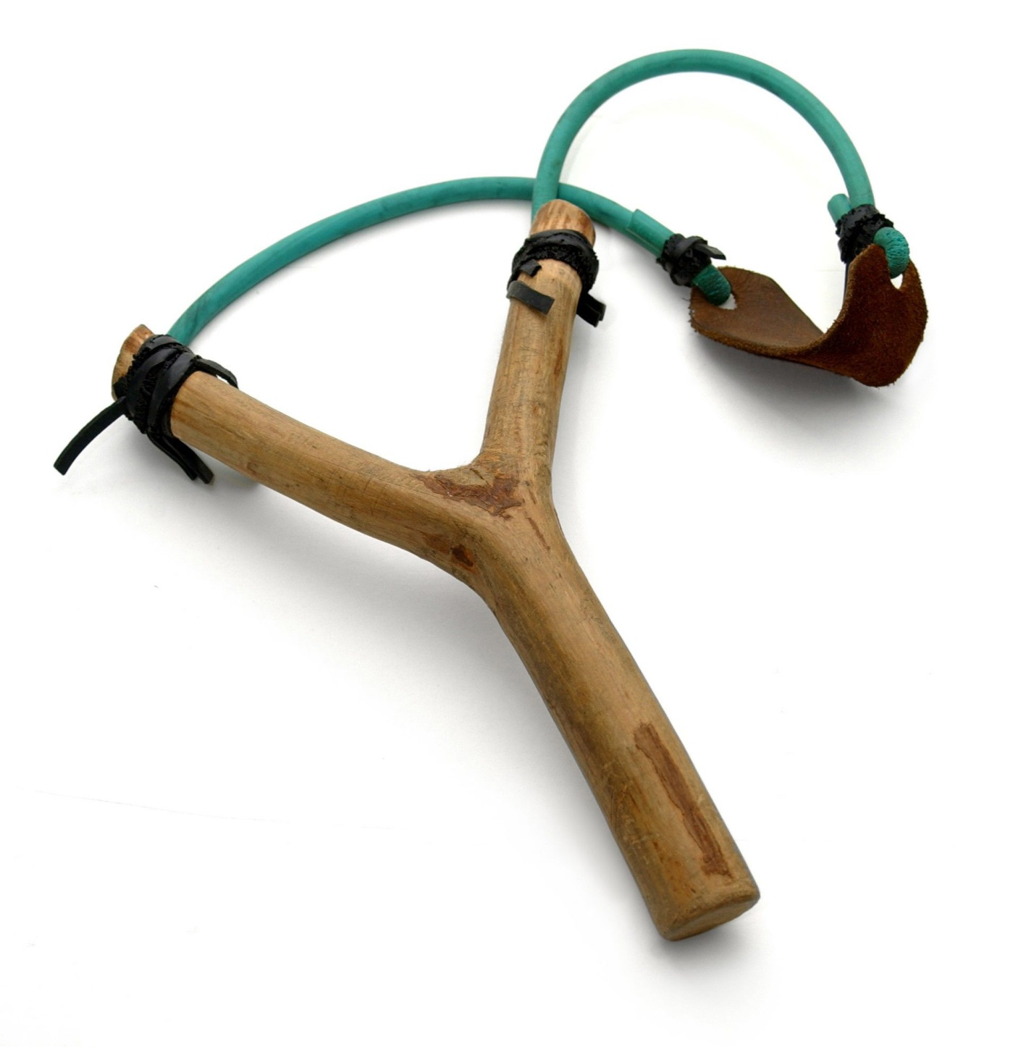
Where SMEs can be big
Notes:
Sometimes small companies are very big in their market segment.
SMEs who participate actively in IEC work are able to defend their position and interests in the face of very large multinationals.
This results in overall better and more broadly relevant international standards.

Slide 23
Focused innovation
Learn from mistakes and leap over development hurdles
Assess the value of innovations vs competition
Improve quality and market reputation
Notes:
During discussion with peers experts often learn from the mistakes others made before them. This allows companies to leap over development hurdles.
Standardized measurement and rating methodologies make it easier compare the value of an innovation.
By using IEC International Standards and participating in their development, companies are able to increase their market reputation.

Slide 24
World’s biggest think-tank
Access world-class experts
Networking breaks: opportunity to discuss ideas and challenges
20 000 experts at the global level
Different backgrounds, many needs = better Standards
Notes:
During standards meetings, experts are able to interact with often world renowned experts for free. During networking breaks they can discuss ideas or problems. They can learn from the best about potential solutions. Often their company would have to pay a lot of money to a consultancy to get the same.
The IEC is one of the biggest think-tanks in the world with a platform that unites 20 000 experts at the global level.
The cooperation and exchanges of experts from many different countries and backgrounds makes international standards more relevant. It ensures that all needs and many solutions are taken into account. This makes the standards more applicable for the whole industry and easier to adopt by each country.

Slide 25
Early market information
Technical and business intelligence
Anticipate new standards
Understand conformity assessment requirements
In step with new regulations - pre-empt new requirements
Notes:
Active participation in IEC work provides advance insights into where technologies and the competition are heading.
It allows companies to anticipate how markets might develop, getting market intelligence that is worth a lot of money.
Companies also learn when standards are updated or new standards are developed. Many governments base their laws and regulations on IEC International Standards. By participating in and using IEC International Standards it is easier to remain in step with new regulations.

Slide 26
Return on investment
Ensure technologies are taken into account
Identify market differences, avoid variations
Reduce cost, increase flexibility
Eliminate duplication and waste
Notes:
When experts participate in the standardization process, they are able to ensure that all relevant technologies of their company are taken into account. Standards identify market differences which can then be built into a product at the development stage or streamlined at production. This helps companies limit market variations that can be costly and reduce a company’s commercial flexibility.

Slide 27
Buy and sell anywhere
Bigger opportunities, more markets
But only with International Standards – not when using national or regional standards
Notes:
IEC International Standards provide built-in interoperability, performance and quality levels that make it easier for suppliers to deliver consistent products that are accepted beyond borders.
SMEs are able to buy standardized parts from suppliers anywhere in the world.
Much of this is impossible with national or regional standards.

Slide 28
How to participate
Through National Committee
Information about IEC work available on IEC website http://www.iec.ch to everyone
Access to documents is responsibility of National Committee
Participation in standards work is responsibility of National Committee
Public Commenting
Notes:
Companies can participate through the National Committee, which is the member of the IEC.

Slide 29
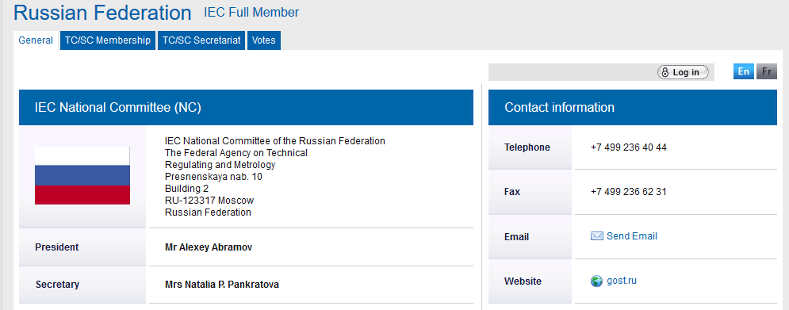
IEC National Committee
Every country has an IEC National Committee
Contact information on: www.iec.ch

Slide 30
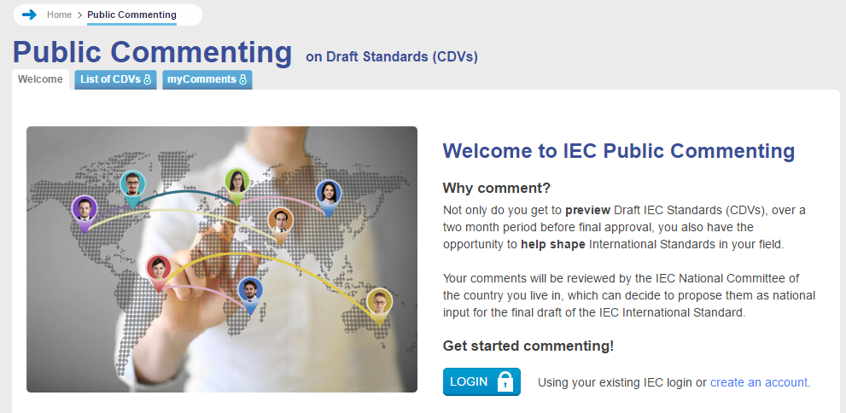
Public Commenting
Experts can view and comment on Draft IEC Standards (CDVs)
http://www.iec.ch/comment
Notes:
Experts can also view and comment on draft IEC Standards via the IEC website.

Slide 31
Make your voice heard
Notes:
When many stakeholders participate in the standardization process, International Standards become better, more relevant and are easier to adopt at the national level.

Slide 32
global market access
Gabriela Ehrlich
IEC Global Head Public Affairs & Advocacy
Standardization Forum 2019
10 October 2019
St. Petersburg, RF
Notes:
Thank you for your attention.

