Slide 1
New model of participant‘s interaction – experience from Austria – „Dialogue forum construction“
Forum „Standardization – 2019“, St. Petersburg
10th – 11th October 2019

Slide 2
Facts & Figures
4 343
Participants
437
new participants
100% of CEN technical committees
144 Committees
271 Working groups
911 Revised editions
Austrian participation
in
22 751
ÖNORM-Standards
Austrian Standards
91% of ISO technical committees
7% Purely national ÖNORM
284 First editions
29 Committees for CEN
manages
21 Committees for ISO
Status: December 2018

Slide 3
International Significance of Standardization
We ensure that experts play a leading role in shaping European and international standards.
Level
National
European
International
General standardization
Electrotechnology
Telecommunication

Slide 4
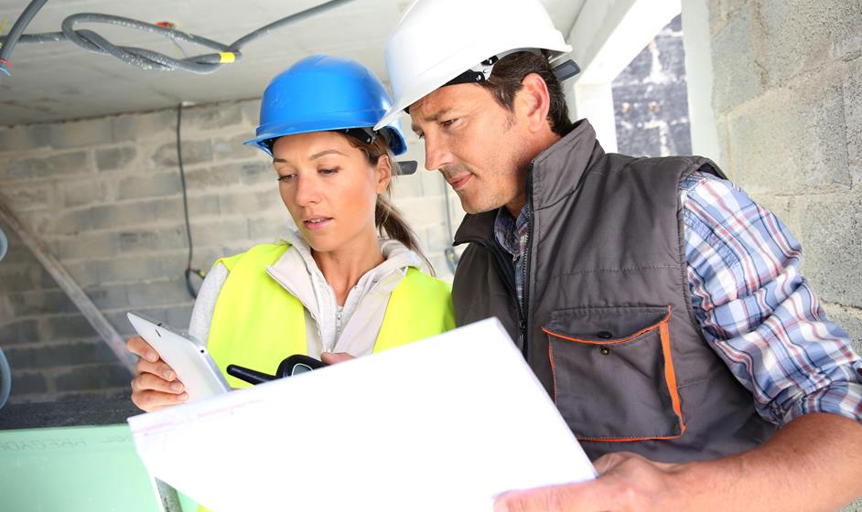
Dialogue forum construction – Why?
Large number of regulations (voluntary and mandatory) in the area of construction
Strong criticism and complaints about very complicated application of regulatory and normative documents in that area
Lack of an overview about interlinks between national law, European directives, ordinances and standards
The target was to simplify the whole complex of the documents

Slide 5
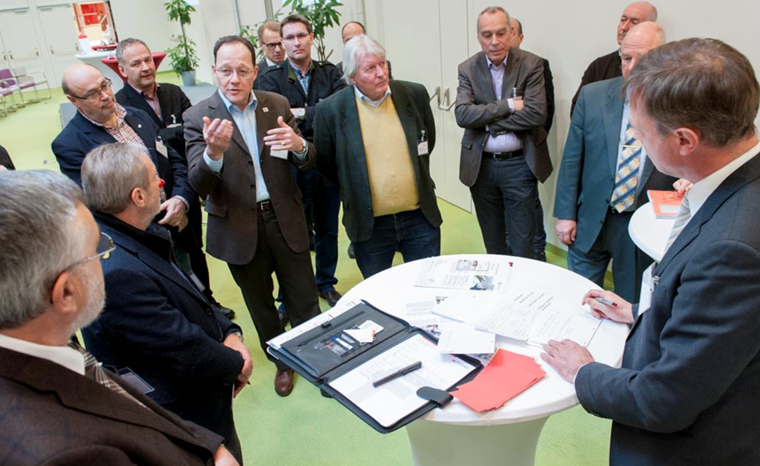
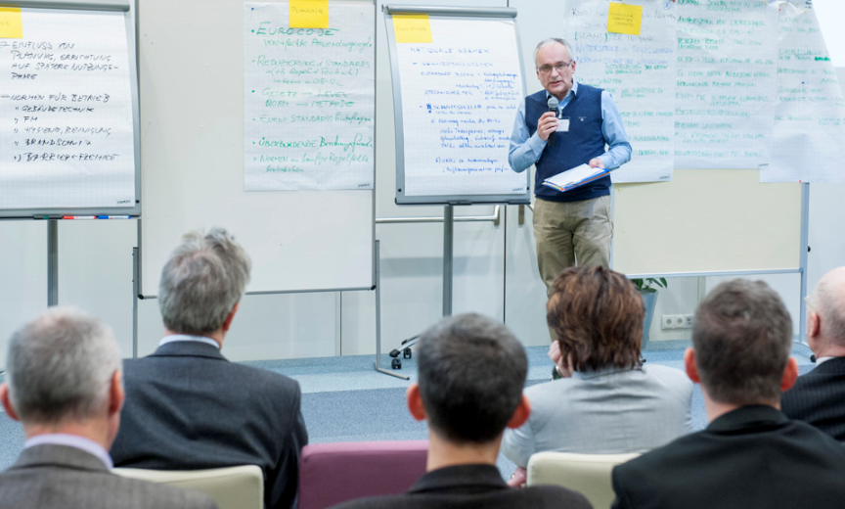
Dialogue forum construction
Initiated at the beginning of 2016 by Austrian Standards and Chamber of Commerce
400 persons from all areas of construction sector active
New and open process of participation (free of charge)
Managed and chaired by an independent expert

Slide 6
Dialogue forum construction – 5 areas of activity
Subproject 1
Subproject 2
Subproject 3
Subproject 4
Subproject 5
REVISION OF STANDARDS
Basing on the proposals from dialogue forum construction
FUERTHER DEVELOPMENT OF STANDARDS
SOLUTION FOR THE ISSUE OF PARALLEL STANDARDS
REVIEW AND AMENDMENT OF CONSTRUCTION REGULATIONS
LIABILITY REGULATIONS
Aim
Implementation of the recommendations, critical reflexion
Systematic and sustainanble improvement
Horizontal co-ordination
Involvement of the provincial government; Review on the parliamentary level
Legal alignment
Lead
Austrian Standards
Austrian Standards
OIB – Österreichisches Institut für Bautechnik
GS Bau, WKÖ, BI Baunebengewerbe, FV Steine Keramik
GS Bau, WKÖ, BI Baunebengewerbe, FV Steine Keramik

Slide 7
Dialogue forum construction – structure of the project
Phase 1 – January 2016 – May 2017
Kick-off Meeting
4 SC-Meetings
2 On-line chats
10 Working Groups
Final conference

Slide 8
Dialogue forum construction – structure of the project
Phase 2 – May 2017 – up to date
Recommendations under implementation in TCs of Austrian Standards International
Direct contacts and exchange with politicians on the federal and provincial level
Activities for deregulation
Yearly congress for construction law and standards

Slide 9
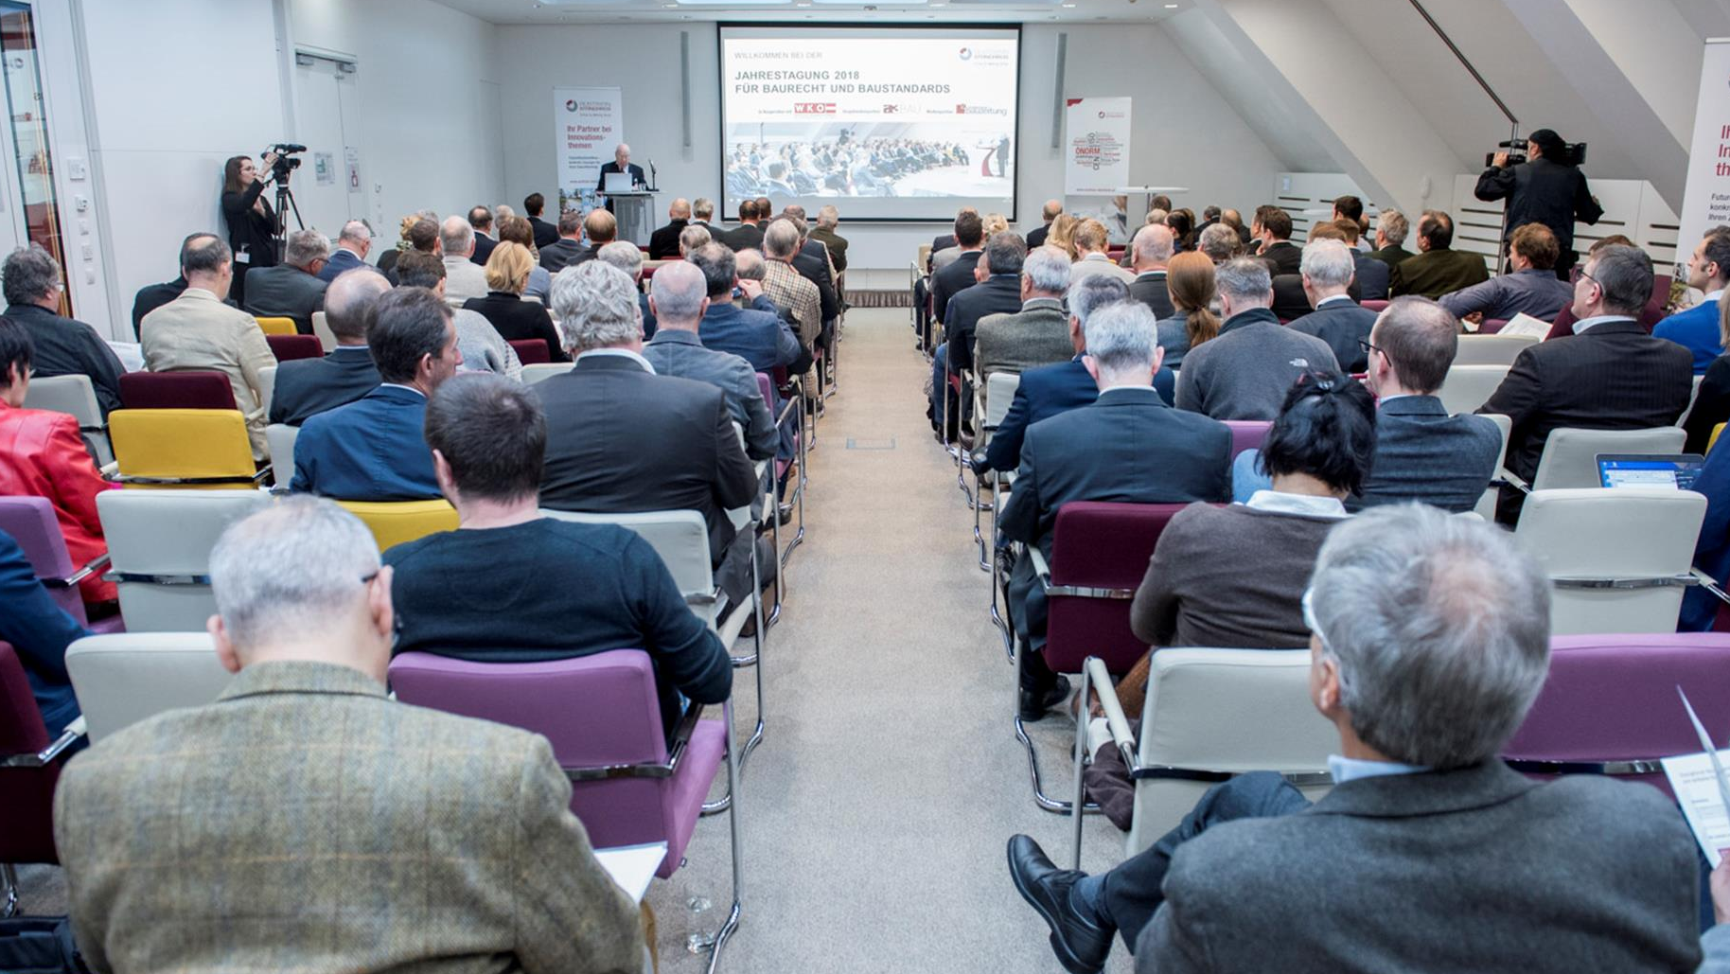
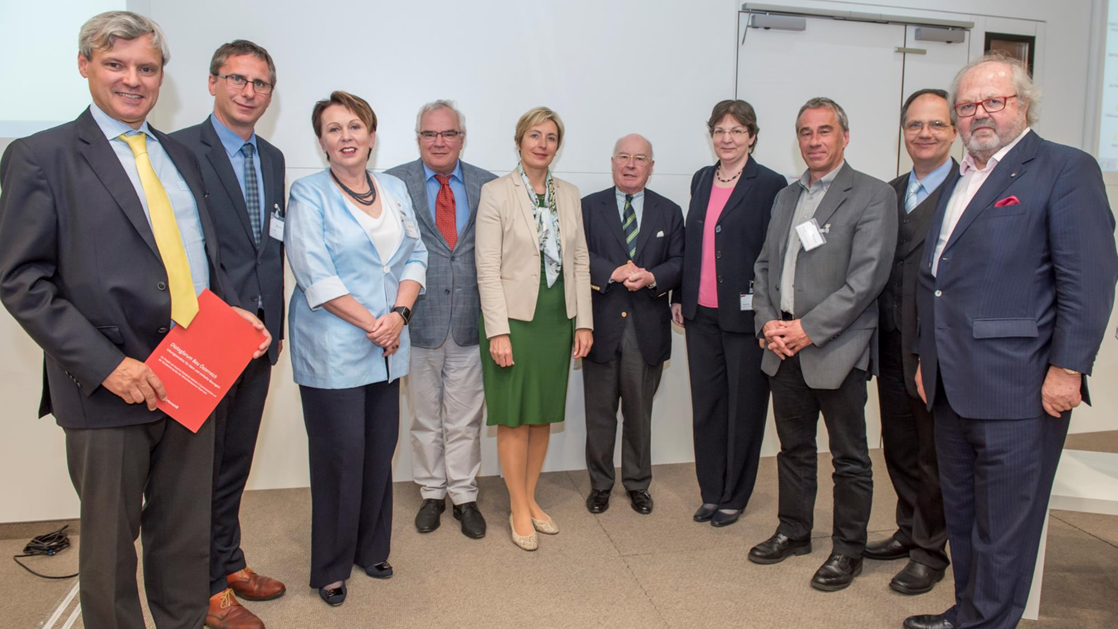
Dialogue forum construction – examples of results
53 recommendations for improvements in Austrian standards
Report „Handlungsbedarf zur Erhöhung der Rechtssicherheit im Bauwesen“
„Geschäftsordnung“ (working procedures) of Austrian Standards International has been revised

Slide 10
Dialogue forum construction – examples of results
Horizontal co-ordination groups for elimination of conflicting specifications established (e.g. fire safety)
Deregulation in construction has been positioned in governmental programme 2017
Yearly construction discussion forums

Slide 11
Thank you for your attention
Joanna Gajdek, Head of Consulting
Austrian Standards International
Heinestraße 38
1020 Vienna Austria
T: +43 1 213 00-616
F: +43 1 213 00-650
M: +43 6644545954
E: j.gajdek@austrian-standards.at

